Slide 1


General Information for Students
Rules of procedure to students at the Faculty of Informatics during the state of emergency due to the coronavirus
Faculty of Informatics, University of Debrecen
22 March 2020

Slide 2
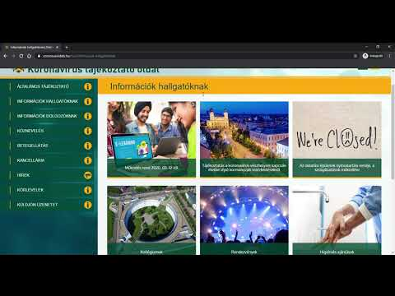
General and specific instructions at university level
https://corona.unideb.hu/en/
This web page contains up-to-date and authentic information related to the coronavirus. Please actively monitor the information posted on this web page.
We ask all our colleagues and students to act together for our own and others’ health.

Slide 3
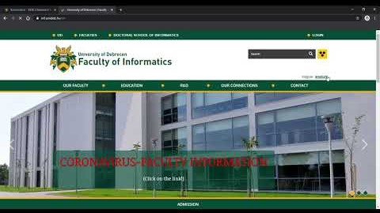
This page containst DEIK general and specific instructionsout the coronavirus.
Distance education information
Office hours
General measures
Contact information
https://inf.unideb.hu/en/coronavirus-deik

Slide 4
Opening hours of buildings
Entry to the IK building is currently solved with an access card/reception assistance, the rear entrance is closed.
Students may enter the building only in particularly justified cases, in which case the request can be made at corona@inf.unideb.hu e-mail address.

Slide 5
General distance learning procedure for students
According to the regulations of the University of Debrecen, the Faculty of Informatics organizes distance learning from 23 March 2020 until its withdrawal.
During distance learning, students are not allowed to enter the educational building.
During distance education, the Faculty of Informatics will use the Moodle e-learning system of the University of Debrecen for official course administration. All university students have access to the system.

Slide 6
Moodle
The content of the curriculum to be taught does not change, the provisions of the accepted syllabus at the beginning of this semester shall continue to apply. However, the way of learning is adapted to technical possibilities.
The continuously updated https://inf.unideb.hu/en/distance-learning website provides support for distance learning.
Lecturers will register course materials continuously in the e-learning system. Students may use the course materials for their own learning purposes only, complying with copyright and GDPR provisions.

Slide 7
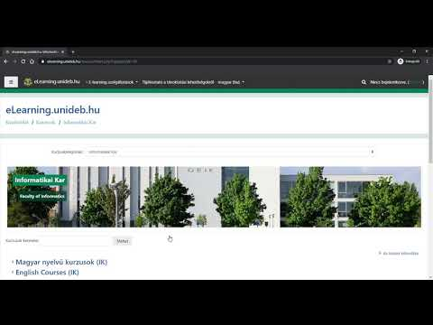
Moodle system
https://elearning.unideb.hu/?lang=en

Slide 8
Lectures (all forms of training)
The content of the presentations are the same as the professional material previously published in syllabus.
During distance learning, the lecturer, following schedule provides 1 online consultation time per minimum 3 lectures throughout the lecture (typically 100 minutes). Online availability times will be registered in Moodle.
Replacement of lectures happens as usual: by replacing of the lecturer. In default of replacement, new appointment will be made with the students and the differences will be recorded in the Moodle system.

Slide 9
The lecturers supplement the material of the lectures with a performance evaluation that is suitable for the students to continuously measure their progress. Students are asked to take advantage of these distance learning tools that enable active learning during the term.
During the 1st week of distance learning, each lecturer will ensure the online presence at the time of the class for the duration of the briefing.

Slide 10
Practices / labs (all forms of training)
The same requirements are valid to the holding of practices (seminars) and labs.
All practices, labs will be held at their scheduled time. Tutors will provide an online consultation time in at least 50% of the duration of the practice / lab at the time of the class. The exact times will be indicated by the tutor in the Moodle system.

Slide 11
The tutor prepares and provides an electronic curriculum as an extra solution in addition to any other forms through the distance learning system.
The student is required to report on the progress of the practice / lab curriculum at regular intervals set by the tutor. At most 3 weeks may pass between two subsequent reports. Typical form may be the solution of homework assignments or performing practical tests. The method of implementation will be indicated in Moodle.

Slide 12
Curriculum of other programs (all forms of training)
The method of fulfilling the classes is determined by the department of other program, the defined terms and conditions are constantly updated on the website (https://inf.unideb.hu/en/coronavirus-deik).

Slide 13
Exams
Syllabus requirements concerning exams have been suspended. You will be informed due in time about the way of exams (signature / mark / terminal examinations / state exam).

Slide 14
Thesis
For graduate students the submission deadline of the thesis is prolonged, the new deadline is 8 May 2020. You will be informed about any further issues later.
Submission deadline of the application form for thesis is prolonged:
24 April 2020 instead of 3 April 2020 (old program before 2017)
21 May 2020 instead of 30 April 2020 (new program after 2017)
You will be informed about the way of submission later.

Slide 15
Consultation hours
Lecturers are required to provide consultation hours during the distance learning, at the time specified at the beginning of the semester, through an online communication channel.
The preferred channel by the instructor is available on the faculty website.
Please note that no face-to-face consultation can be requested from any lecturer during an emergency.

Slide 16
Addictional Information
If you have any administrative, technical or procedural questions, please do not hesitate to contact the Educational Office (to@inf.unideb.hu).
Beside using the distance learning system, Neptun will remain the primary communication channel. Students are kindly asked to check regularly the incoming Neptun messages from Educational Office.

Slide 17
In connection with professional, course-related content questions, please contact lecturers via email or, in their consultating hours, using the provided online communication channel.
Other questions/comments can be sent to the corona@inf.unideb.hu email address or by filling in the Contact Form:
https://inf.unideb.hu/en/contact-form-coronavirus

Slide 18
The current state of emergency requires increased attention and cooperation from all of us, especially in the communication between students and lecturers.
Faculty of Informatics does not want to limit the technical details of distance learning more than it is strictly necessary. Hence, students will use different platforms during distance learning.
You are asked to deal with these issues in a flexible way, knowing that by using these platforms you will acquire competencies that will surely be useful to you in the future with the spread of teleworking.

Slide 19
Hygienic recommendations
Wash your hands with warm water and soap thoroughly and frequently.
Use hand sanitizer.
Refrain from greetings with personal contact (handshakes, kisses, etc.)
Do not rub your eyes and refrain from touching your face.
Use a paper tissue when coughing or sneezing. Apply the hygienic rules of coughing. Through used paper tissues into the garbage.
Disinfect frequently used/touched items and surfaces (computer keyboards, door handles, etc.).
Open the windows to let fresh air in frequently.
As far as possible, avoid crowds when travelling and in your free time.

Slide 20
We call your attention that, due to the high virulence of the disease, young people – while being symptom-free carriers or having mild symptoms only – can represent a direct threat to the lives of those in the older generations; therefore, the responsibility of young people is uniquely important, even in a historic scale, toward the elders, including their own relatives!

Slide 21
Please stay home!

Slide 22
Faculty of Informatics of UD wishes you good job and good health!

